Slide 1
Image Representation
Course Code: CSC 3224
Course Title: Computer Graphics
Dept. of Computer Science
Faculty of Science and Technology
Lecturer No: | 03 | Week No: | 2 | Semester: | Fall 2021-2022
Lecturer: | Shahnaj Parvin, sparvin@aiub.edu

Slide 2
Outline
Pixel
Graphics Image
Color Model (RGB, CMY)
Direct Coding
Lookup Table
Display Monitor
Printing
Image Files
Books
References

Slide 3
Computer Graphics
Computer graphics is an art of drawing pictures, lines, charts, etc using computers with the help of programming.
Computer graphics is made up of number of pixels. Pixel is the smallest graphical picture or unit represented on the computer screen.
The definition of computer graphics is that Visual representation and manipulation of pictorial data by a computer.

Slide 4
Pixel
A pixel is one of the many tiny dots that make up the representation of a picture in a computer's memory.
Pixels in an image can be reproduced at any size without the appearance of visible dots or squares
The intensity of each pixel is variable; in color systems, each pixel has typically three or four dimensions of variability such as red, green and blue, or cyan, magenta, yellow and black

Slide 5
Graphics consists of
All point addressable graphics (APA) -
The APA mode assumes a pixel-oriented display and has the advantage that you can change the pixels of a graphic individually and do not have to change the entire display.
For example, When printing barcodes, the APA mode is important because all points of the barcode can be set individually.
Real time method-
involves getting the CPU respond to user immediately.
User entering information and the computer replying on the display within tolerable time delay.
Examples: Graphs- pie-charts, histograms, modern trend-
video games, multimedia.

Slide 6
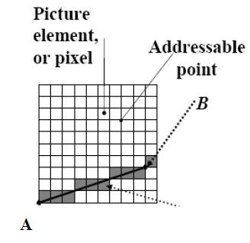
Pixel

Slide 7
Pixel
Identification of pixel
VGA mode- the number of pixels in VGA mode is fixed at 640 x 480. (480 rows of 640 pixels = total 307200 pixels)
(0,0) X-axis
Origin
(639, 0)
Y-axis
(0, 479)
(639, 479)

Slide 8
Pixel
Address of pixel
Pixel is the smallest addressable screen element which can be controlled.
The monitor can be visualized as one dimensional array of pixels.
Thus each pixel has an address, which can be computed as:
address of P(i,j) = addr(0,0) + j x imax +i
where imax is the maximum number of pixels in a row,
j = number of rows .
0<= i < imax and 0<= j < jmax .
(In standard VGA mode imax = 640 and jmax = 480)

Slide 9
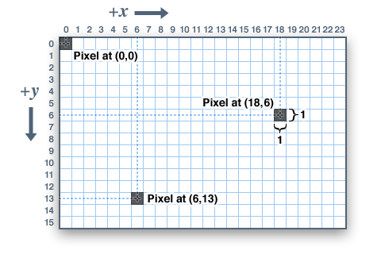
Pixel

Slide 10
Address of a Pixel Exercise
Problem 1 :
Consider you have a screen with VGA Mode of 15 x 12.
If a Pixel P(i , j) has co-ordinate P(8,6) then determine
the Address of P(i , j). Also Show the Pixel position on the graph.
Problem 2 :
Consider you have a screen with VGA Mode of 12 x 10. If a Pixel P(i , j) has co-ordinate P(8,9) then determine the Address of P(i , j). Also Show the Pixel position on the graph.

Slide 11
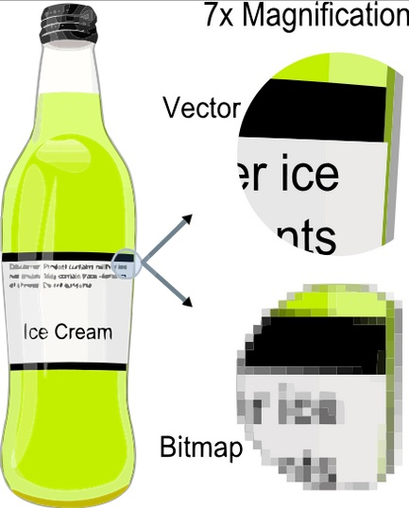
Types of Computer Graphics
Raster Graphics: where each pixel is separately defined (as in a digital photograph)
Vector Graphics: where mathematical formulas are used to draw lines and shapes, which are then interpreted at the viewer's end to produce the graphic.
Vector Graphics can be magnified infinitely without loss of quality, while pixel-based graphics cannot.

Slide 12
Raster Image
Raster graphics are bitmaps.
A bitmap is a grid of individual pixels that collectively compose an image.
Raster graphics render images as a collection of countless tiny squares.
Each square, or pixel, is coded in a specific shade. Individually, these pixels are worthless
Together, they’re worth a thousand words

Slide 13
Raster Image
Using of Raster Image
Raster graphics are best used for non-line art images; specifically digitized photographs, scanned artwork or detailed graphics
Non-line art images are best represented in raster form because these typically include subtle chromatic gradations, undefined lines and shapes, and complex composition

Slide 14
Drawbacks of Raster Image
Resolution in raster graphics is measured in dpi, or dots per inch. The higher the dpi, the better the resolution
Raster files are significantly larger than comparable vector files, high resolution raster files are significantly larger than low resolution raster file
Overall, as compared to vector graphics, raster graphics are less economical, slower to display and print, less versatile and more unwieldy to work with

Slide 15
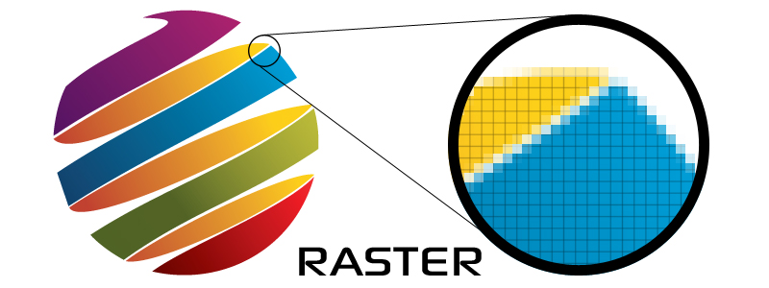
Example of Raster Image
Common raster formats include TIFF, JPEG, GIF, PCX and BMP files

Slide 16
Vector Image
Unlike pixel-based raster images, vector graphics are based on mathematical formulas that define geometric primitives such as polygons, lines, curves, circles and rectangles

Slide 17
Use of Vector Image
Because vector graphics are composed of true geometric primitives, they are best used to represent more structured images, like line art graphics with flat, uniform colors.
Most created images meet these specifications, including logos, letterhead, and fonts.

Slide 18
Advantages of Vector Image
Vector-based graphics are more malleable than raster images
They are much more versatile, flexible and easy to use
The most obvious advantage of vector images over raster graphics is that vector images are quickly and perfectly scalable
There is no upper or lower limit for sizing vector images

Slide 19
Advantages of Vector Image
Unlike raster graphics, vector images are not resolution-dependent
Vector images have no fixed intrinsic resolution, rather they display at the resolution capability of whatever output device (monitor, printer) is rendering them
Because vector graphics need not memorize the contents of millions of tiny pixels, these files tend to be considerably smaller than their raster counterparts.

Slide 20

Vector Images
Overall, vector graphics are more efficient and versatile.
Common vector formats include AI, EPS, CGM, WMF and PICT (Mac).

Slide 21
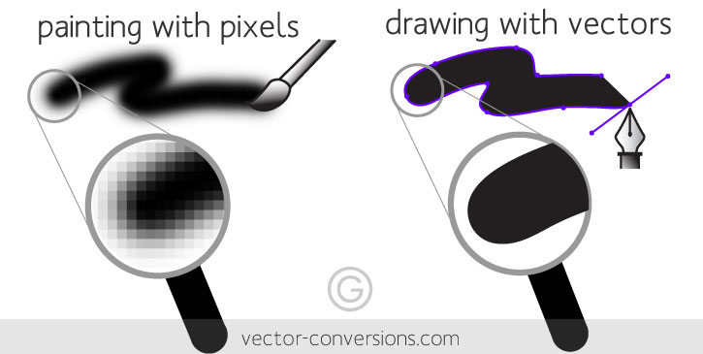
Raster vs Vector
Raster images are made of pixels. A pixel is a single point or the smallest single element in a display device. If you zoom in to a raster image you may start to see a lot of little tiny squares.
Vector images are mathematical calculations from one point to another that form lines and shapes. If you zoom into a vector graphic it will always look the same.

Slide 22
Interactive Computer Graphics
Interactive Graphics: Interactive computer graphics user have some control over the picture i.e user can make any change in the produced image.
Interactive Computer Graphics involves a two way communication between computer and user.
Here the observer is given some control over the image by providing him/her with an input device for example the video game controller of the ping pong game.
This helps him/her to signal the request to the computer. The computer on receiving signals from the input device can modify the displayed picture appropriately.

Slide 23
Non-Interactive Computer Graphics
Non Interactive Graphics: In non interactive computer graphics images can not be changed.
That’s why it is also known as passive computer graphics.
It is the computer graphics in which user does not have any kind of control over the image
In Passive Computer Graphics, Image is merely the product of static stored program and will work according to the instructions given in the program linearly.
The image is totally under the control of program instructions not under the user.
Example : Screen Savers

Slide 24
Color Model
A color model is a system for creating a full range of colors from a small set of primary colors.
There are two types of colour models: additive and subtractive.

Slide 25
Additive and Subtractive Model
Additive color models use light to display color
While subtractive color models use printing inks.
Colors perceived in additive models are the result of transmitted light.
Colors perceived in subtractive models are the result of reflected light.

Slide 26
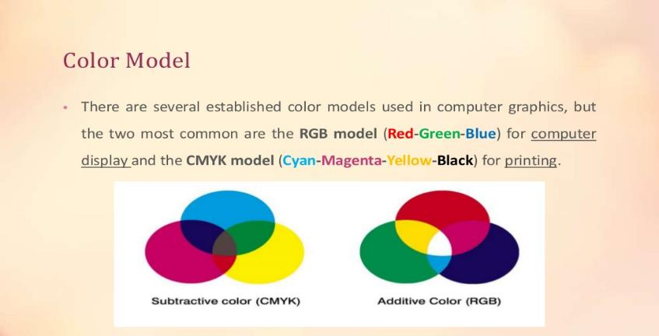
RGB and CMYK

Slide 27
RGB
RGB uses additive color mixing, because it describes what kind of light needs to be emitted to produce a given color.
Light is added together to create form from out of the darkness.
RGB stores individual values for red, green and blue.
(r,g,b)=>(0,0,0) black, (1,1,1) white [ranges 0 to 1]

Slide 28
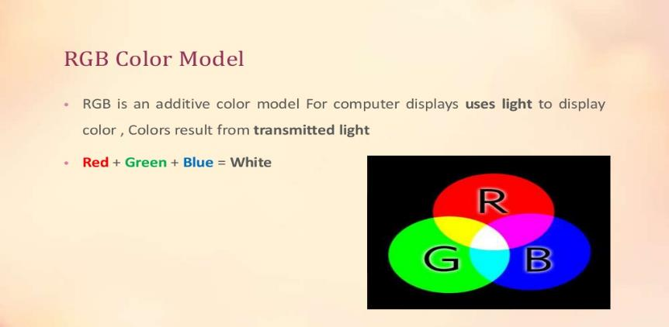
RGB

Slide 29
RGB
0,1,1
Cyan
1,1,1
White
0,1,0
Green
1,1,0
Yellow
G
0,0,1
Blue
1,0,1
Magenta
B
R
0,0,0
Black
1,0,0
Red

Slide 30
RGB Value
A color's RGB value indicates its red, green, and blue intensity.
Each intensity value is on a scale of 0 to 255

Slide 31
RGB Color Palette
3-bit RGB
Systems with a 3-bit RGB palette use 1 bit for each of the red, green and blue color components. That is, each component is either "on" or "off" with no intermediate states. This results in an 8-color ((2¹)³ = 2³ = 8) palette
6-bit RGB
Systems with a 6-bit RGB palette use 2 bits for each of the red, green, and blue color components. This results in a (2²)³ = 4³ = 64-color palette

Slide 32
Color Palette
In computer graphics, a color palette is a finite set of colors. Palettes can be optimized to improve image accuracy in the presence of software or hardware constraints.

Slide 33
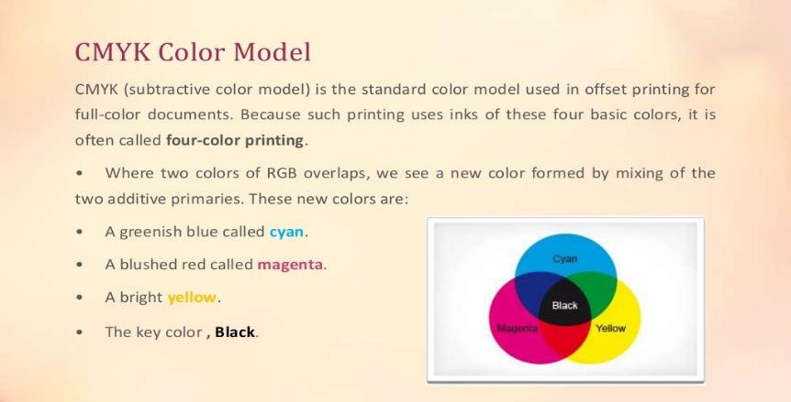
CMYK

Slide 34
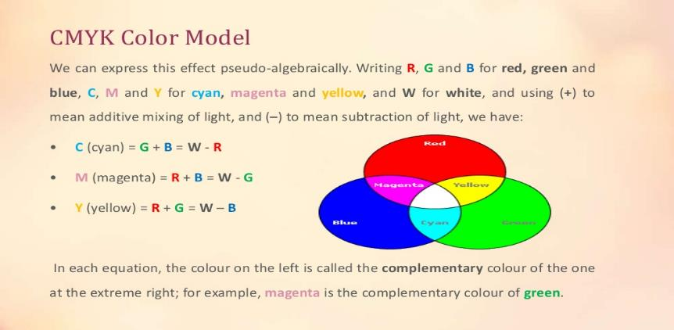
CMYK

Slide 35
CMY
0,1,1
Red
1,1,1
Black
0,1,0
Magenta
1,1,0
Blue
M
0,0,1
Yellow
1,0,1
Green
Y
C
0,0,0
White
1,0,0
Cyan

Slide 36
CMY
CMY uses subtractive color mixing used in the printing process, because it describes what kind of inks need to be applied so the light reflected from the substrate and through the inks produces a given color.
One starts with a white substrate (canvas, page, etc.), and uses ink to subtract color from white to create an image.
CMYk stores ink values for cyan, magenta, yellow, Key(Black).
cmyk(c%, m%, y%)=>(0%,0%,0%) white. [ranges from 0 to 100%]

Slide 37
RGB to CMY Color
The conversion from RGB to CMY is given by the formula
Example : The red colour is written in RGB as (1,0,0). In CMY it is written as
that is, magenta and yellow.

Slide 38
CMY to RGB Color
Example : The magenta is written in CMY as (0,1,0). In RGB it is written as
giving,
that is, red and blue.

Slide 39
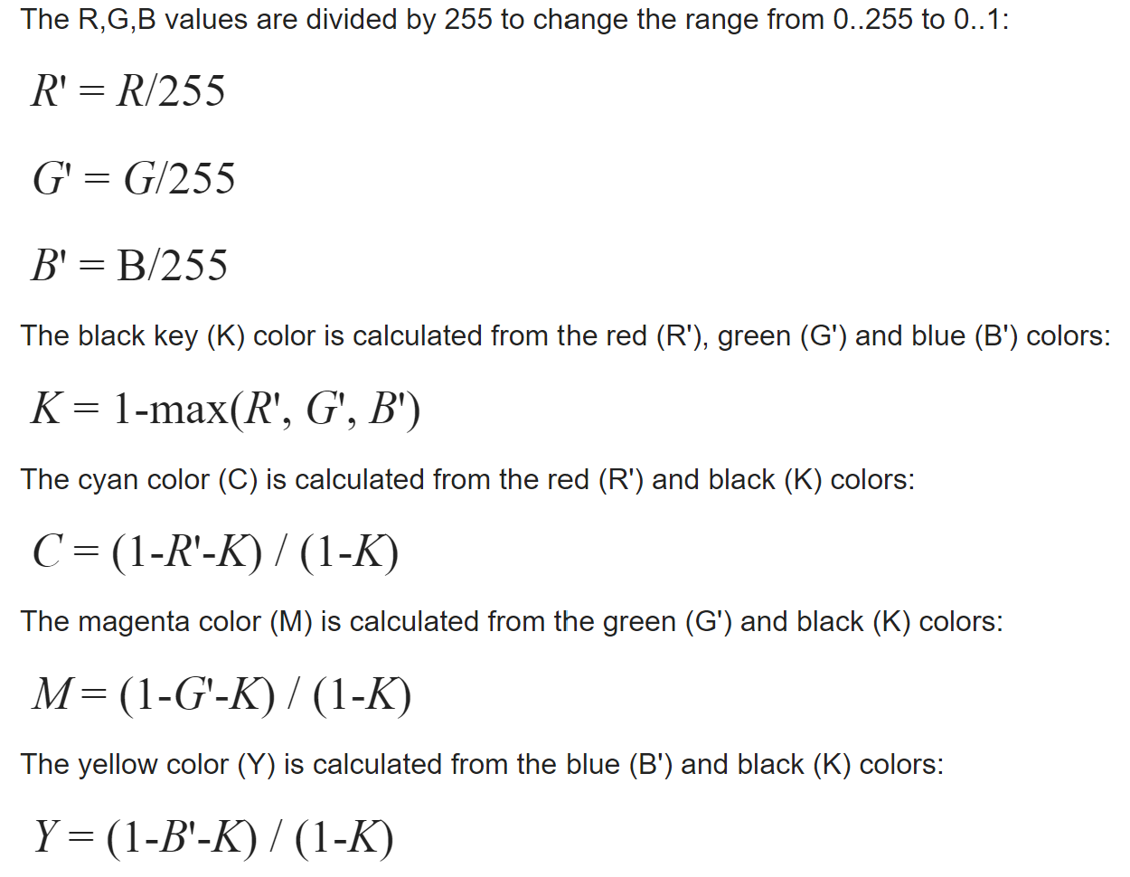
Another RGB to CMYK conversion

Slide 40
Example
Suppose you are designing a logo on your computer, and you have used the
following colors:
(132, 94, 194), and (78, 131, 151) Now convert your RGB values, so that they can be used for printing.

Slide 41
RGB to CMY
C = 1 –( color.R / 255.0);
M = 1 – (color.G / 255.0);
Y = 1 – (color.B / 255.0);

Slide 42
RGB to CMY
R = (1 - C) * 255.0,
G = (1 - M) * 255.0,
B = (1 - Y) * 255.0

Slide 43
RGB -> CMY -> RGB
More info
http://colormine.org/convert/rgb-to-cmy
Sample Code:
https://github.com/THEjoezack/ColorMine/blob/master/ColorMine/ColorSpaces/Conversions/CmyConverter.cs

Slide 44
HSV Color Model
The components of the HSV colour space are Hue, Saturation and Value.
Colour is the result of the perception of light at different wavelengths.
Usually, we do not experience light at a single wavelength but a blend of waves at different wavelengths.

Slide 45
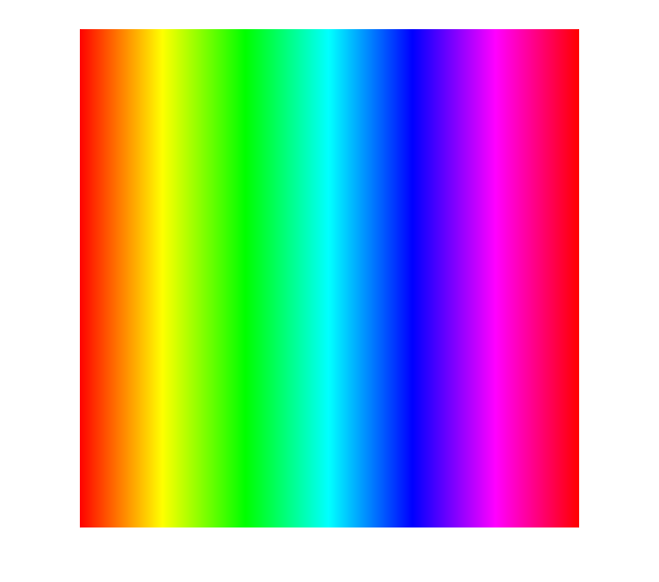
Hue
The hue corresponds to the dominant wavelength and determines the type of the colour, for example red, green, or blue.
The HSV spectrum of bright pure colours ( s = 1, v = 1 ).
Notice the cyclicality of the hue. The red corresponds both to h=0 and h=1.
h = 0
h = 1

Slide 46
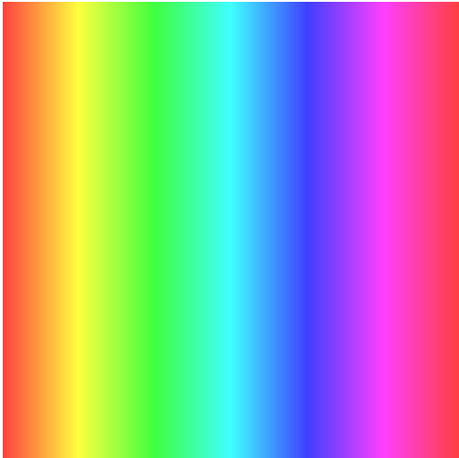
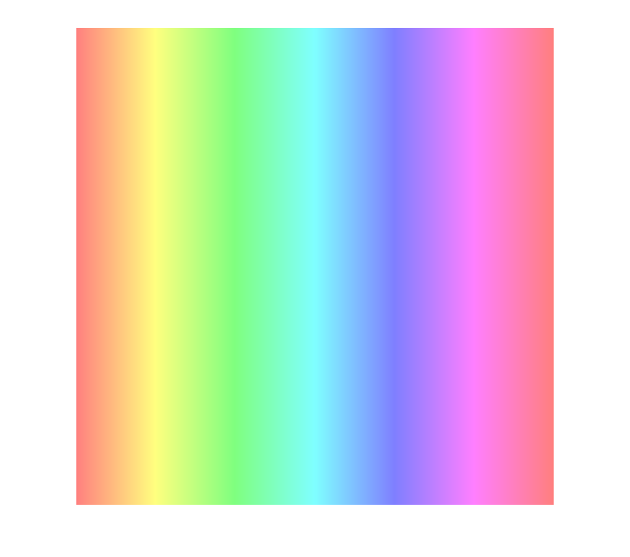

Saturation
The saturation determines the purity of the colour.
High saturation gives pure colours (narrow wavelength band),
while low saturation means colours mixed with a lot of white
(white light combines all the visible wavelengths).
Bright colours (v=1) with decreasing values of saturation.
s = 1
s = 0.75
s = 0.5
s = 0.25

Slide 47
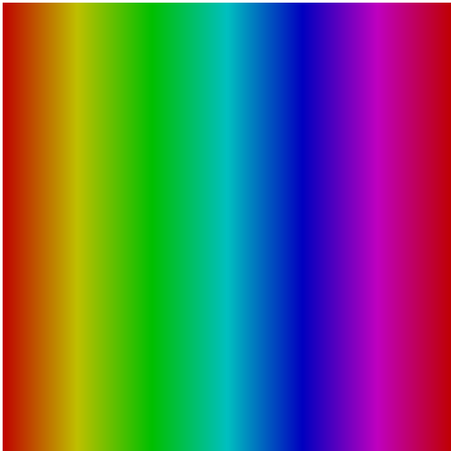
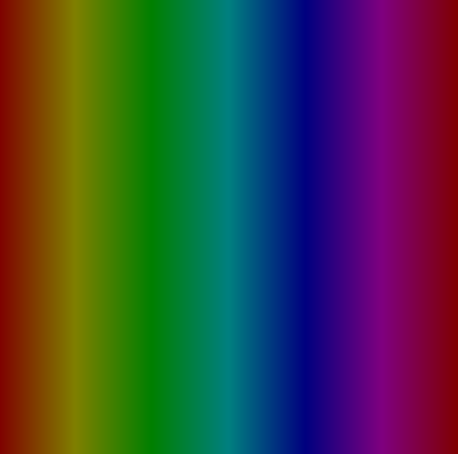
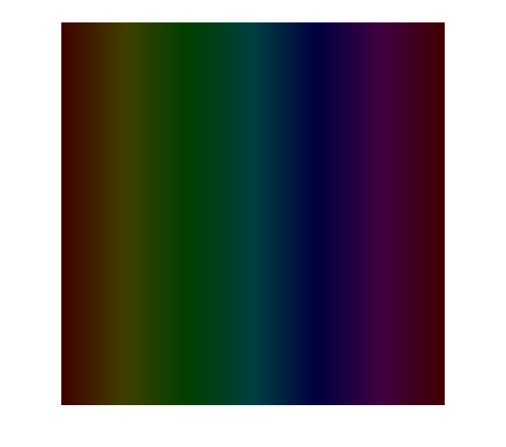
Value
The value determines the brightness.
A value equal to zero represents absence of light, while a high value gives bright colours.
Pure colours (s=1) with decreasing values of “value” (brightness).
v = 1
v = 0.75
v = 0.5
v = 0.25

Slide 48
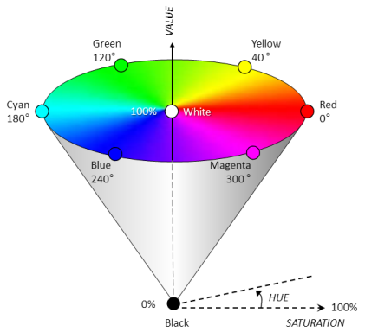
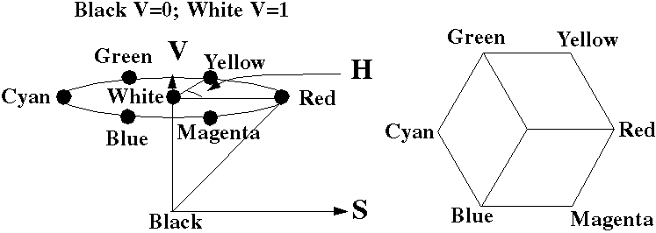
HSV Color Model
When we map the RGB cube on the HSV cylinder we get a subset of this cylinder in the shape of a pyramid with a hexagonal base.
RGB, CMY models are hardware- oriented.
HSV(hue, saturation, value) or HSB (brightness) model is user-oriented.

Slide 49
Direct Coding
Basically, images are the collections of several pixels with colors. In computer graphics, direct coding is an algorithm that provides some amount of storage space for each pixel so that the pixel is coded with a color.

Slide 50
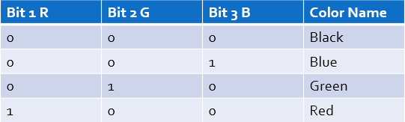
Direct Coding
Storage space for each pixel to code the color
Use 3 bits per pixel (1 for R, 1 for G and 1 for B) [Industry standard]
256 different intensity level for each color

Slide 51
Direct Coding
More info of direct coding:
https://www.chegg.com/homework-help/definitions/direct-coding-3

Slide 52
Lookup Table
In computer graphics, lookup tables are used to store the starting addresses of each line and the values corresponding to the placement of pixels within a byte.

Slide 53
Steps to plot a point using lookup table
1. Locate the starting address corresponding to the line on which the point is to appear.
2. Locate the address of the byte in which the point will be represented.

Slide 54
Lookup table
y
RED
max
GREEN
255
BLUE
1
1
0
y
0
0
67
Pixel displayed
0
1
1001
1010
0001
at x', y'
0
67
2465
Pixel in
R
G
B
bit map
0
0
at x', y'
0
x
x
max
Bit map
Look-up table
Display
Video look-up table organization: each table entry is a 12 bit per entry.
A pixel with value 67 is displayed on the screen containing the value in the table is 2465 - with the red electron gun at 9/15 (binary 1001) of maximum, green at 10/15, and the blue is 1/15.

Slide 55
Problem
Display Color Map Look-Up Table with Bit-Plane for the following Video look-up table organization:
Each Table entry is a 12 bit per Entry. A Pixel with value 79 is displayed on the screen containing the value in the table is 2081 which indicates the values for the Red, Green and Blue electron gun.

Slide 56
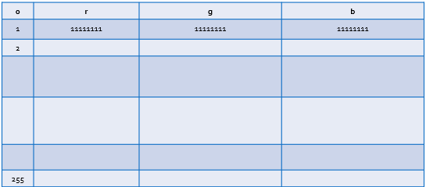
Lookup Table
Pixel values do not code colors directly
Refer to a table of color values
A table with 256 colors with RGB values

Slide 57
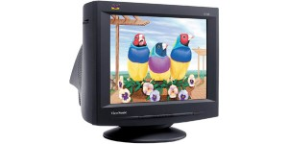
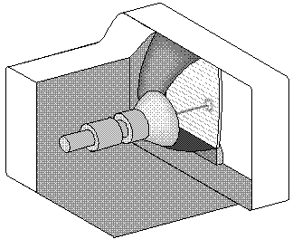
Display Monitor (CRT)
Focusing
System
Base
Y deflect
Phosphor
Connector
Pins
x deflect
Electron
Gun
Control
grid
voltage

Slide 58
Components of CRT:
Electron Gun: Electron gun consisting of a series of elements, primarily a heating filament (heater) and a cathode. The electron gun creates a source of electrons which are focused into a narrow beam directed at the face of the CRT.
Control Electrode: It is used to turn the electron beam on and off.
Focusing system: It is used to create a clear picture by focusing the electrons into a narrow beam.
Deflection Yoke: It is used to control the direction of the electron beam. It creates an electric or magnetic field which will bend the electron beam as it passes through the area.
Phosphorus-coated screen: The inside front surface of every CRT is coated with phosphors. Phosphors glow when a high-energy electron beam hits them. Phosphorescence is the term used to characterize the light given off by a phosphor after it has been exposed to an electron beam.

Slide 59
Printing
Halftone
Go through chapter 2 (schaum’s outline) for details.

Slide 60
Halftone
Halftone is the technique that simulates continuous tone imagery through the use of dots.
Dots can be varied either
in size
in shape or
in spacing
Halftone generates a gradient like effect.

Slide 61
Halftone Image
A halftone, or halftone image, is an image comprised of discrete dots rather than continuous tones. When viewed from a distance, the dots blur together, creating the illusion of continuous lines and shapes.
By halftoning an image (converting it from a bitmap to
a halftone), it can be printed using less resources

Slide 62
How Halftone work
Halftone process, in printing, a technique of breaking up an image into a series of dots so as to reproduce the full tone range of a photograph or tone art work.

Slide 63
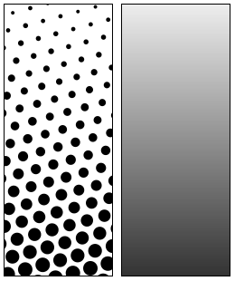
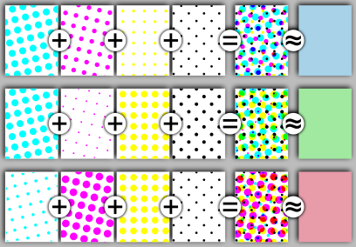
Example

Slide 64
Books
Foley, van Dam, Feiner, Hughes, Computer Graphics: principles and practice, Addison Wesley, Second Edition.
Schaum's Outline of Theory & Problems of Computer Graphics.
Peter Shirley Steve Marschner , “Fundamental of computer graphics”, Third Edition.

Slide 65
References
http://colormine.org/convert/rgb-to-cmy
www.howstuffworks.com
www.wikipedia.com
http://www.picturetopeople.org/image_effects/photo-halftone/examples/photo-to-halftone-convertion-2.gif
http://mocoloco.com/fresh2/upload/2011/12/halftone_calendar_by_casey_klebba/halftone_calendar_casey_klebba_3b-thumb-468x468-35319.jpg
https://www.chegg.com
https://www.slideshare.net/mustafasalam167/color-model-29181025
https://www.printcnx.com/resources-and-support/addiational-resources/raster-images-vs-vector-graphics/
https://slideplayer.com/slide/5143930/

